Slide 1

Welcome to CanJS!
CanJS 2.0 Overview
Why CanJS?
Future Meetups
TodoMVC
@justinbmeyer
Notes:
I am Justin Meyer
Welcome to the first CanJS meetup!
Today we are going to talk:
a bit about the goals for these meetups.
Give an introduction to CanJS 2.0 while we build TodoMVC with CanJS.
Finally, we’ll end with QA and an open forum for questions.

Slide 2
Meetup Checklist
Big thanks to STL JS + Michael!
Make sure audience asks questions.
Gauge audience’s experience.
Notes:
Now to scratch off a checkboxes on my meetup checklist:
Thank Cars.com hosting us.
1. I like an interactive meetup. If you have a question / thought, raise your hand immediately.
2. How many people:
Are using CanJS daily?
Have experimented with CanJS?
Know almost nothing about canjs?
What would you like from this meetup? What do you want to get out of it?

Slide 3
CanJS is a JavaScript library that makes developing complex applications simple and fast. Easy-to-learn, small, and unassuming of your application structure, but with modern features like live-binding and computed values. Creating apps is easy and maintainable.

Slide 4
1.1 Features
Constructors can.Construct
Observables can.Map, can.List, can.compute
Models can.Model
Routing can.route
Templates can.view.ejs, can.view.mustache
Controls can.Control
Notes:
JavaScript has 10 basic data types.
mutable

Slide 5
can.Construct.extend(s,p)
var Person = can.Construct.extend({
init: function (name) {
this.name = name;
}
});
var curtis = new Person("Curtis");
curtis.name
Notes:
JavaScript has 10 basic data types.
mutable

Slide 6
new can.Map(data)
var person = new can.Map({name:'josh'});
person.attr('name') //-> 'josh'
person.bind('name',function(ev,newVal,oldVal){
newVal //-> 'Justin'
oldVal //-> 'josh'
});
person.attr('name','Justin');
Notes:
JavaScript has 10 basic data types.
mutable

Slide 7
new can.List(data)
var hobbies = new can.List(['JS']);
hobbies.attr(0) //-> 'JS'
hobbies.bind('add',function(ev,items,index){
items //-> ['bball','hip hop']
index //-> 1
});
hobbies.push('bball','hip hop');
Notes:
JavaScript has 10 basic data types.
mutable

Slide 8
can.compute(data)
var age = can.compute(30);
age(); //-> 30
age.bind('change',function(ev,newVal,oldVal){
newVal //-> 31
oldVal //-> 30
});
age(31);
Notes:
JavaScript has 10 basic data types.
mutable

Slide 9
can.compute(getter)
var info = can.compute(function(){
return person.attr("name")+" is "+age()+
" and likes: "+hobbies.join(', ')
});
info() //-> "Justin is 31 and likes
// JS, bball, hip hop"
info.bind('change',function(ev,newVal,oldVal){
newVal //-> "Justin is 31 and likes
// JS, bball"
});
hobbies.pop();
Notes:
JavaScript has 10 basic data types.
mutable

Slide 10
can.Model.extend(s,p)
var Task = can.Model.extend({
findAll: "GET /tasks",
findOne: "GET /tasks/{id}",
create: "POST /tasks",
update: "PUT /tasks/{id}",
destroy: "DELETE /tasks/{id}"
},{})
Task.findAll({due:"today"},function(tasks){})
Task.findOne({id: 51},function(task){});
Notes:
JavaScript has 10 basic data types.
mutable

Slide 11
can.Model.extend(s,p)
var task = new Task({name:"Mow lawn."});
task.save(function(){
task.attr("name","Mow and trim lawn.")
.save(function(){
task.destroy()
})
})
Notes:
JavaScript has 10 basic data types.
mutable

Slide 12
can.route(route,defaults)
location.hash //-> "#!"
can.route.attr() //-> {}
can.route.attr("page","recipes");
location.hash //-> "#!page=recipes"
location.hash = "#!page=recipes&id=1"
can.route.attr() //-> { page: "recipes",
id: "1" }
Notes:
JavaScript has 10 basic data types.
mutable

Slide 13
can.route(route,defaults)
can.route(":page/:id");
can.route.bind("id", function(ev, id){
if(can.route.attr(’page') == "recipes"){
if( id ){
Recipe.findOne({id: id});
}e
}
});
location.hash = "#!recipes/1"
Notes:
JavaScript has 10 basic data types.
mutable

Slide 14
Mustache / Handlebars
{{#if devs.length}}
{{#each devs}}
<li>{{name}}</li>
{{/each}}
{{else}}
<li>No Developers</li>
{{/if}}
can.view('devs.mustache',{
devs: new can.List([{name:'Andy'}])
})
Notes:
JavaScript has 10 basic data types.
mutable

Slide 15
EJS
<% if( devs.attr('length') ) { %>
<% devs.each(function(dev){ %>
<li><%= dev.attr('name') %></li>
<% }) %>
<% } else { %>
<li>No Developers</li>
<% } %>
can.view('devs.ejs',{
devs: new can.List([{name:'Andy'}])
})
Notes:
JavaScript has 10 basic data types.
mutable

Slide 16
can.Control.extend( p )
var Tabs = can.Control.extend({
init: function( el ) {
// show first tab
},
'li click': function( el, ev ) {
// hide other tabs
// show selected tab
}
});
new Tabs('#tabs');
Notes:
JavaScript has 10 basic data types.
mutable

Slide 17

2.0 Features!
2-way binding can-value="value"
View binding can-click="method"
Custom tags <tabs>
Components can.Component
Notes:
JavaScript has 10 basic data types.
mutable

Slide 18

var HyperLoop = can.Map.extend({
travelTime: function(){
return this.attr('dist')
/
962 /* km/h */
}
})
var loop = new HyperLoop({
dist: 3429.19 /* Chi <-> SF */
})
var tmp = can.view.mustache(
"<p>Distance: \
<input can-value='dist'/> \
</p> \
<p>Time: \
{{travelTime}} hrs \
</p>")
$("#out").html( tmp(loop) )

Slide 19
can.Component.extend(p)
can.Component.extend({
tag:"panel",
template: "{{#if active}}<content>…",
scope: {
active: false
},
helpers: {}
events: {
inserted: function(){...}
}
})
Notes:
Create a control
Has a view model that you make changes to
Those changes are reflected in some template
You still need to listen to events, especially DOM mutation events

Slide 20
can.Component.extend(p)
<tabs>
<panel title='Frameworks'>
CanJS, JavaScriptMVC, others
</panel>
<panel title='Libraries'>
jQuery, Underscore, etc
</panel>
</tabs>
Notes:
DEMO

Slide 21
2.1 Features!
can.stache <h2>Welcome {{username}}</h2>
map define {get: ,set: ,type: , serialize:}
list promise recipes.isPending()
Notes:
JavaScript has 10 basic data types.
mutable

Slide 22
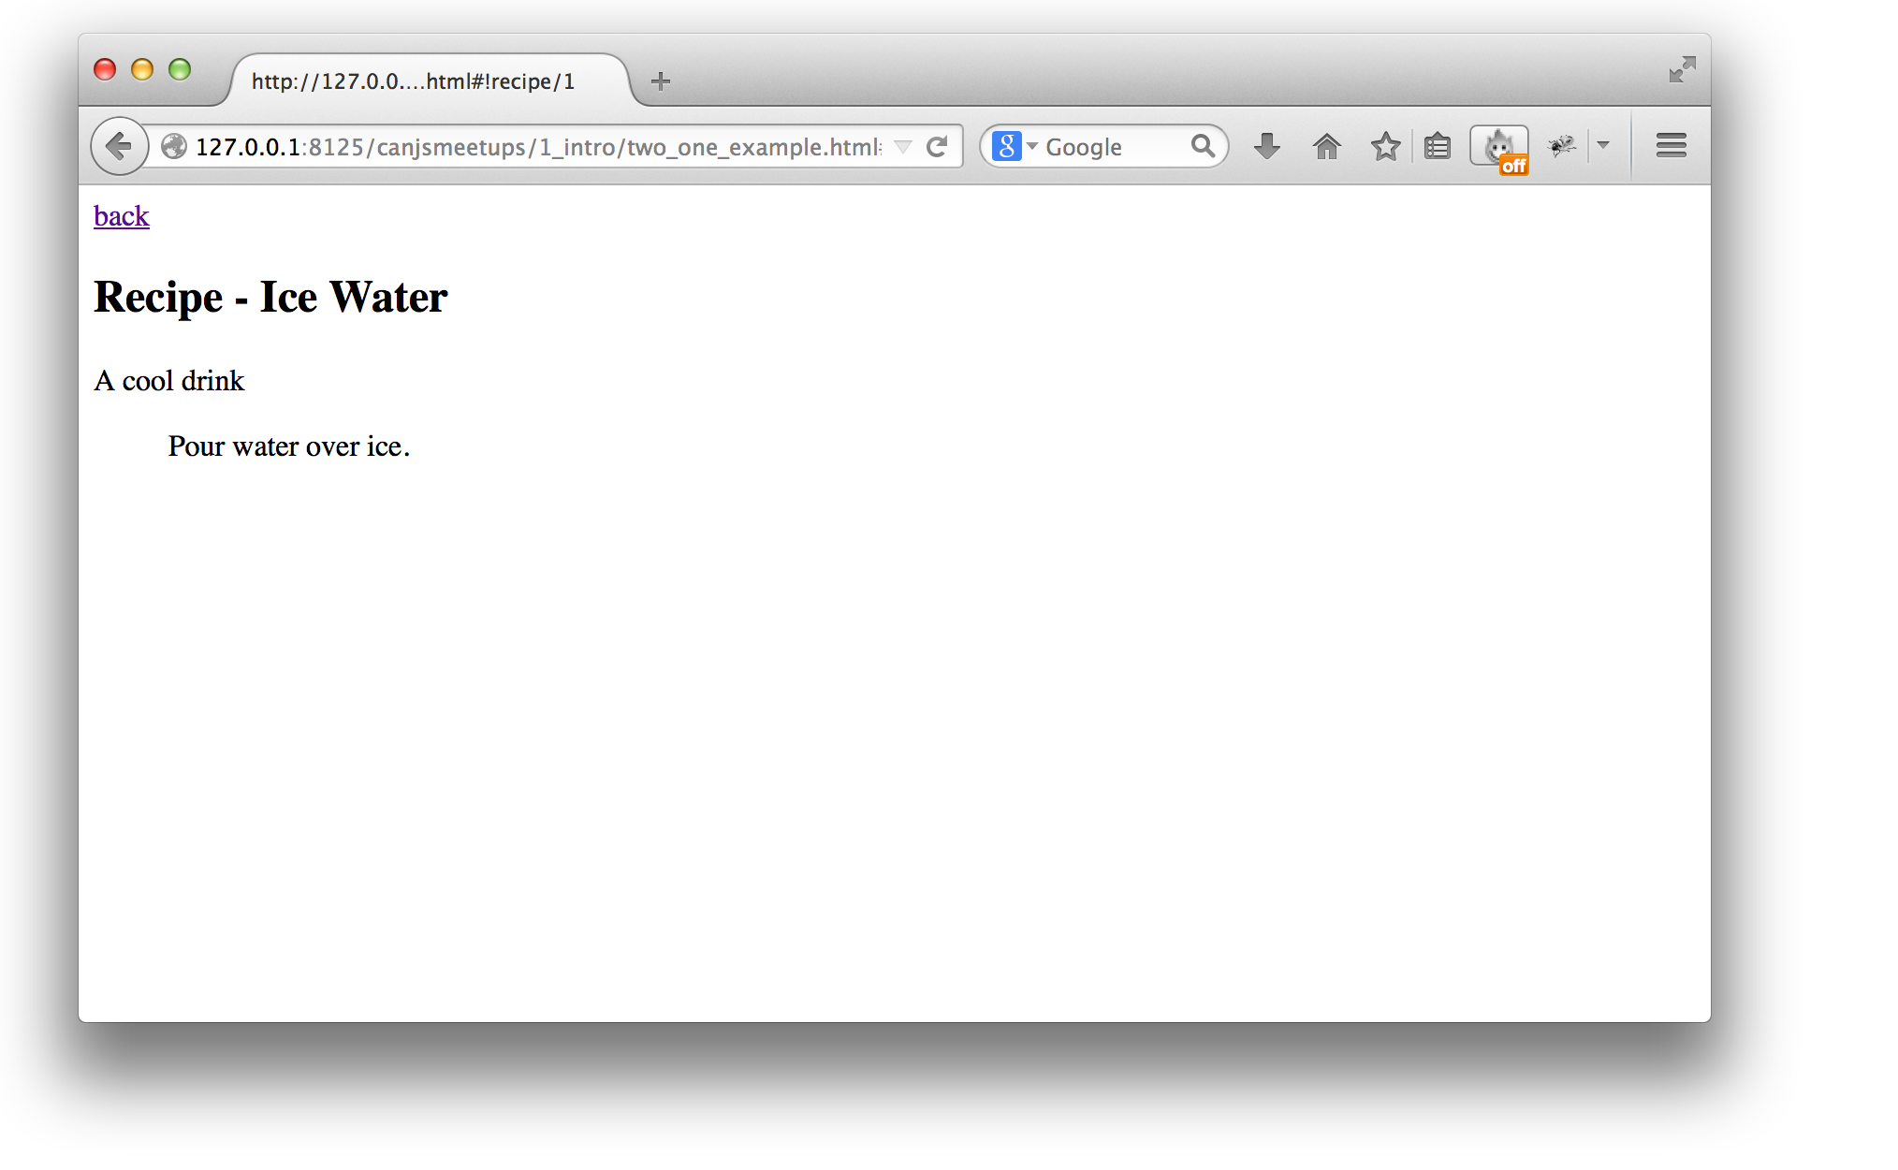

Slide 23
Why?
a framework?
instead of Backbone?
instead of angular?
instead of xyz?

Slide 24
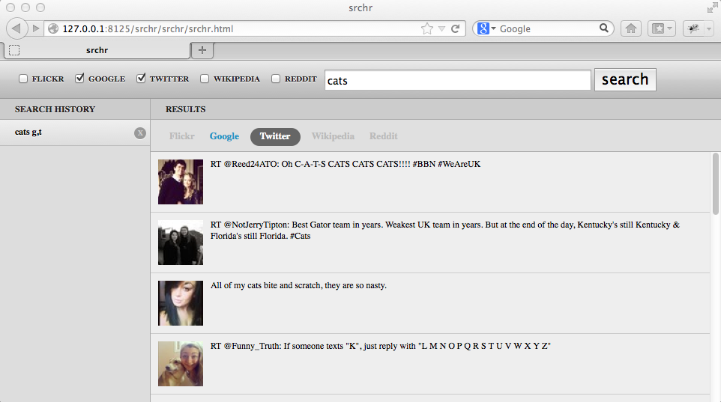

Slide 27
// in search.js
formSubmitted: function(){
var searchData = this.element.formParams();
history.add( searchData )
searchResults.update( searchData )
}

Slide 28
// in search.js
formSubmitted: function(){
var searchData = this.element.formParams();
history.add( searchData )
searchResults.update( searchData )
}

Slide 29
// in search.js
formSubmitted: function(){
var searchData = this.element.formParams();
history.add( searchData )
searchResults.update( searchData )
}
// in history.js
historyItemClicked: function(){
var searchData = this.element.data('search');
searchForm.add( searchData )
searchResults.update( searchData )
}

Slide 30
// in history.js
historyItemClicked: function(){
var searchData = this.element.data('search');
searchForm.add( searchData )
searchResults.update( searchData )
}

Slide 31
// in history.js
historyItemClicked: function(){
var searchData = this.element.data('search');
searchForm.add( searchData )
searchResults.update( searchData )
}

Slide 32
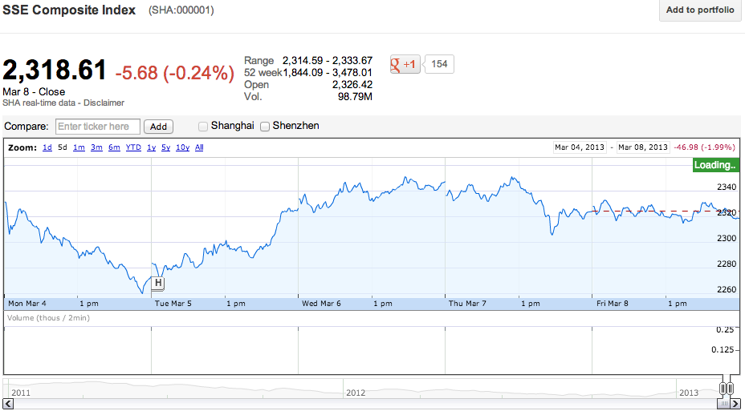

Slide 43
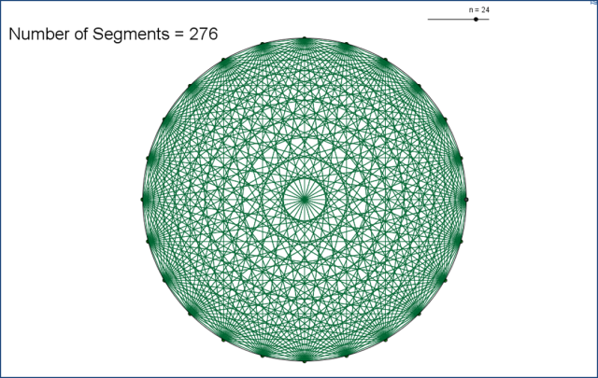

Slide 45
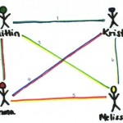

Slide 46
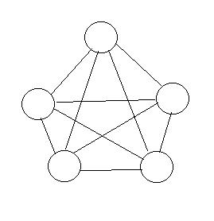

Slide 47
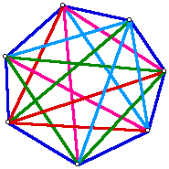

Slide 48
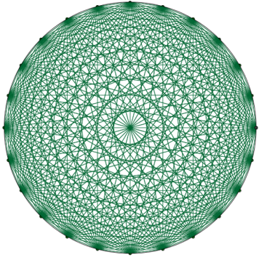

Slide 49
n ( n – 1 ) / 2

Slide 59
{
ticker: "SSE",
startTime: 1350709200000, // Oct 20, 2012
endTime: 1350795600000 // Oct 21, 2012
}

Slide 62
{
query: "cats",
types: ["Google", "Twitter"]
}

Slide 63
{
query: "cats",
types: ["Google", "Twitter"]
}

Slide 64
Search
{
query: "cats",
types: ["Google", "Twitter"]
}

Slide 65
Why – instead of Backbone?
{{Live Binding}}

Slide 66
Why – instead of Angular?
Synchronous Events
Flexibility
Depth
Forever Features

Slide 67
Synchronous Events
No polling for changes.
Side-effects happen immediately.
todos.push({
name: "Test this list",
completed: true
});
equal(
$("#todos li").length,
todos.length,
"todo added to the page");

Slide 68





Flexibility - Library Support
Notes:
Want to appeal

Slide 69
Flexibility – Do it your way
<slider min="0" max="100"></slider>
new Slider("#progress",{
min: 0,
max: 100
});
$("#progress").slider({
min: 0,
max: 100
});
Notes:
views - ejs

Slide 70
Flexibility – Do it your way
Task = can.Model.extend({
findAll: "/GET /tasks"
},{})
Task = can.Model.extend({
findAll: {
crossDomain: true,
dataType: "jsonp",
jsonpCallback: "callback"
}
},{})

Slide 71
Flexibility – Do it your way
Task = can.Model.extend({
findAll: "/GET /tasks"
},{})
Task = can.Model.extend({
findAll: function(params){
var deferred = $.Deferred();
connect(function(data){
deferred.resolve(Task.models(data))
});
return deferred;
}
},{})
Notes:
views - ejs

Slide 72
Depth!
Deferreds
Model store
Plugins
Notes:
JavaScript has 10 basic data types.
mutable

Slide 73
Deferreds
var tasksDeferred = Task.findAll({})
tasksDeferred.then(
function(tasks){
},
function(jQXhr, textStatus, errorThrown){
})
Notes:
JavaScript has 10 basic data types.
mutable

Slide 74
Model Store
Critical
Due Today
File Taxes
Write talk on CanJS
Emissions Test
Brush Teeth
Write talk on CanJS
Check into flight
Notes:
The next way CanJS helps with memory is through it’s non-leaking global store.
Say we have 2 Todo lists, Critical Todos and today’s todos. These lists might get back data for the same instance of a todo. The problem happens when a user changes properties on a todo that exists in both lists. Both lists need to be listening to property changes on the same todo instance.
Model needs to see that the data it retrieves belongs to the same instance and return the previously created instance instead of creating a new one.
Most MVC libraries either ignore it or solve it with a model store that has all instances, when data is retrieved for an instance, it checks if the instance is already created and uses that instance instead of creating a new one.
The problem with this is for long-lived applications, you are constantly collecting unused instances, which fills memory. The developer has to tell the store when to flush instances.
CanJS solves this by keeping things in the store only when it knows you are interested in them. How do you express interest? Well by binding to the instance. So, Model keeps instances in the store only while they have event handlers.
This, combined with templated event handling, means that simply by replacing the todo list ELEMENTs with a list of “Awesome Developers”
<li class=“<%= todo.attr(‘complete’) ? “done” :”” %>” >
Very common, but tricky and critical problem for MVC.
CanJS has a non-leaking global store, that allows it to solve the 2 ‘instance’ problem without permanently storing all model instances.

Slide 75












Model Store
Awesome Developers

Slide 76
Plugins
Validations
Getter / Setter
Backup / Restore
Super
Queue
Delegate
PushState
Fixtures
LazyMap
Notes:
JavaScript has 10 basic data types.
mutable

Slide 77
Forever Features!
Hash Pattern Matching
EJS
Event Delegation
Instance Controllers
Templated events
Class
Model
Observables
Live binding
State routing
Mustache
CanJS 1.0
CanJS 1.1
can.compute
2007 | 2008 | 2009 | 2010 | 2011 | 2012 | 2013
Notes:
JavaScript has 10 basic data types.
mutable

Slide 78
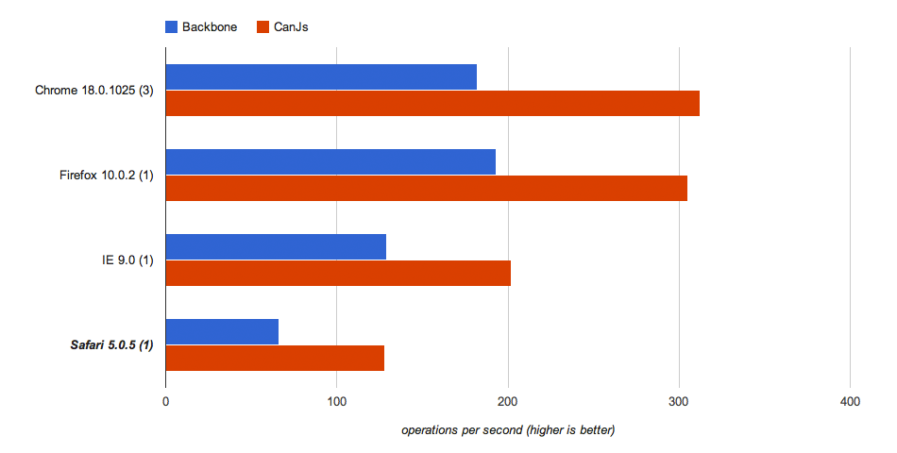
Speed – Tabs Control

Slide 79
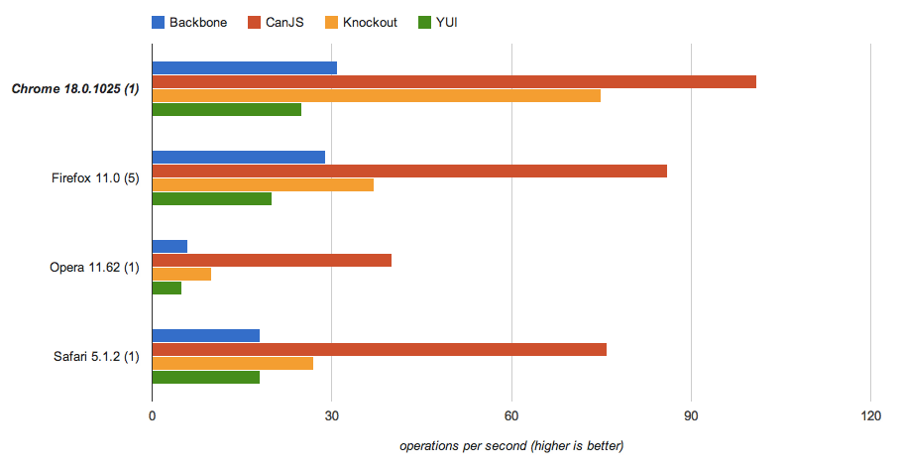
Speed – Live Binding
http://jsfiddle.net/NtBGL/8/

Slide 80
Speed - Size
 | - jQuery
 | -jQuery +Underscore
 | none
 | none
 | -jQuery -handlebars
CanJS 14.4kb
Backbone 11.4kb
Knockout 15.5kb
Angular 30.2kb
Ember 60.6kb

Slide 81
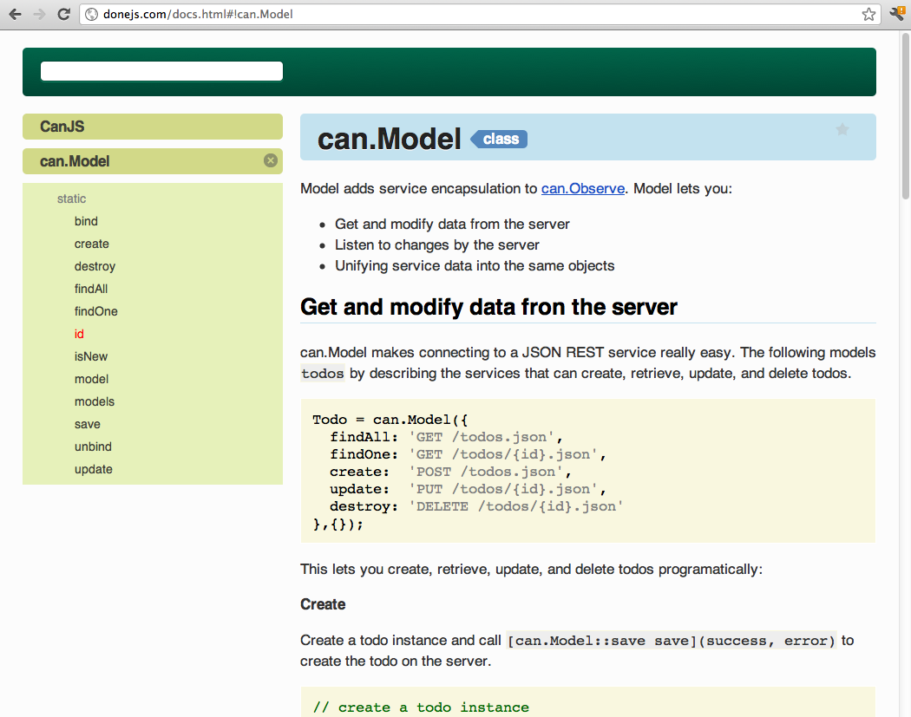
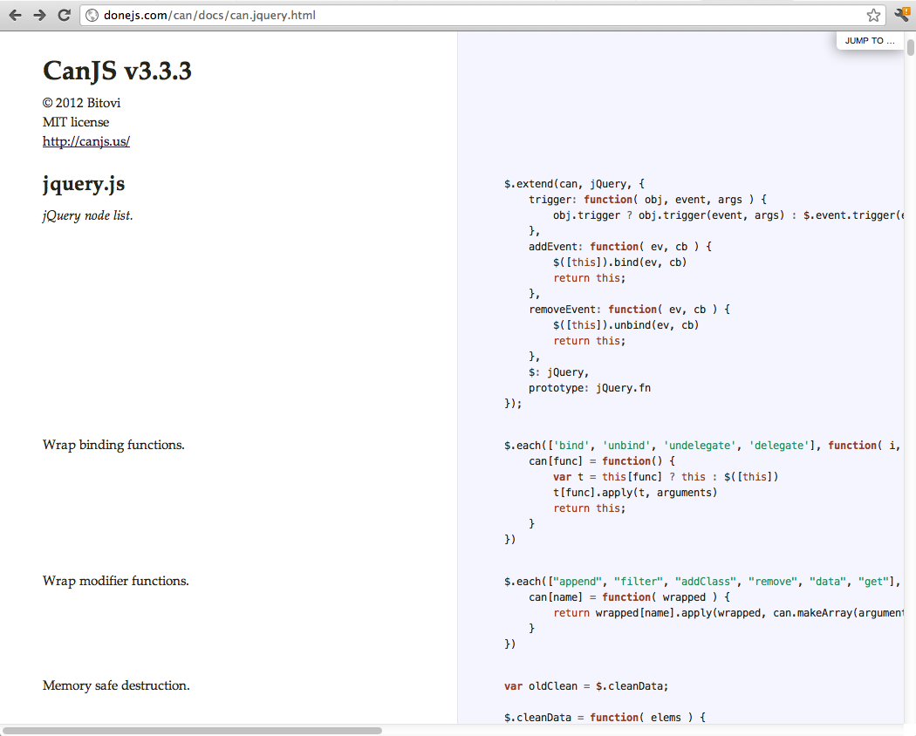
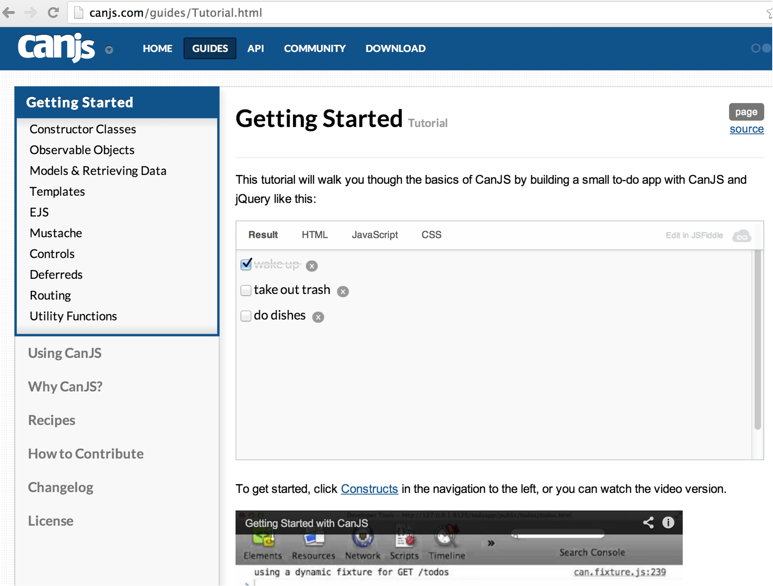
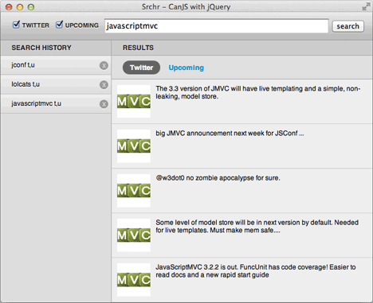
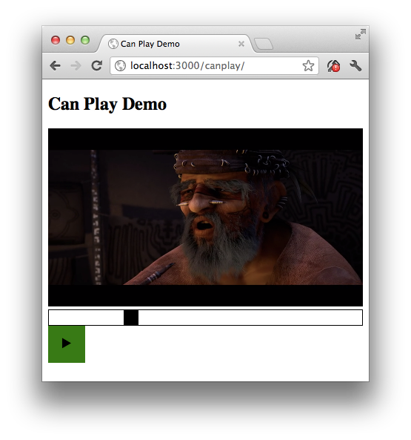
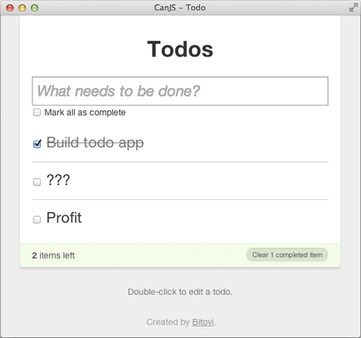
Documentation + Examples

Slide 82
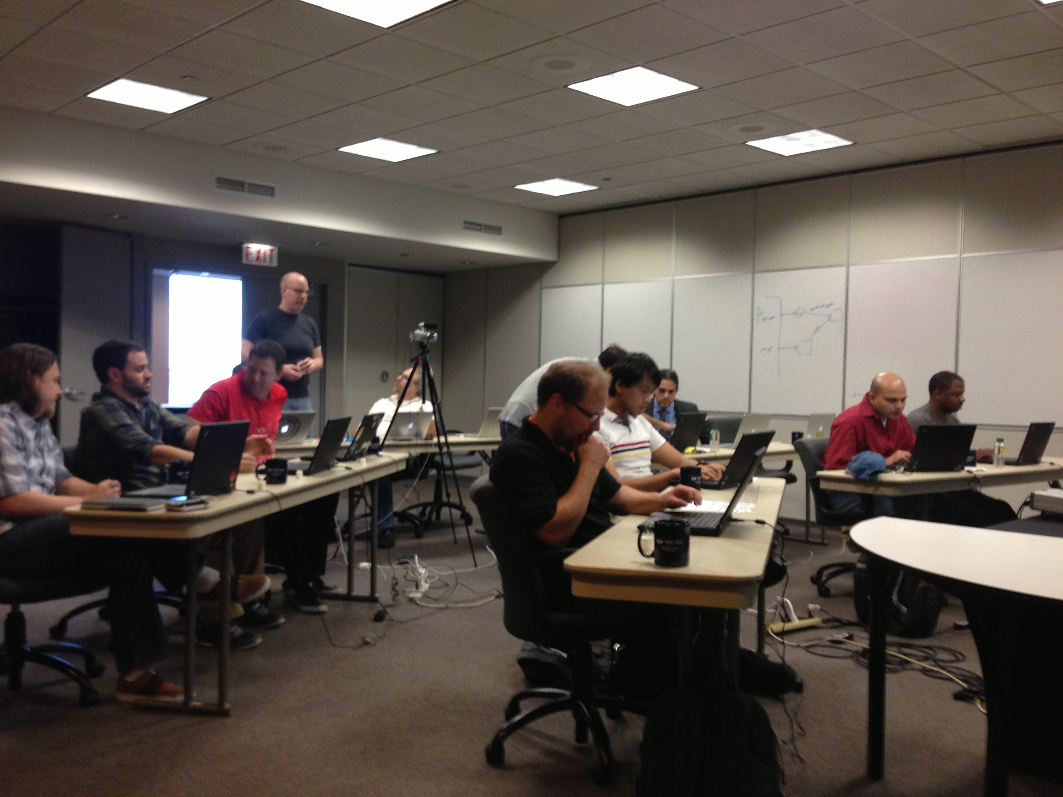

Slide 83
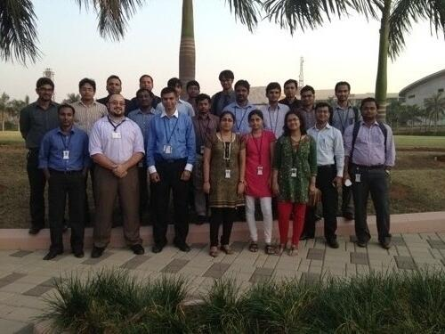
Easy to Learn - Support

Slide 84
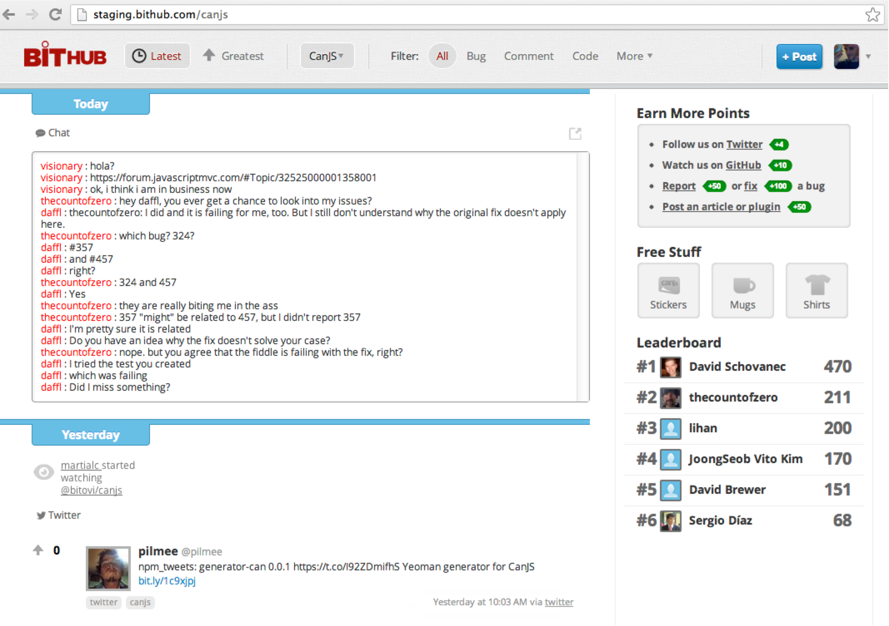
Easy to Learn - Community

Slide 85
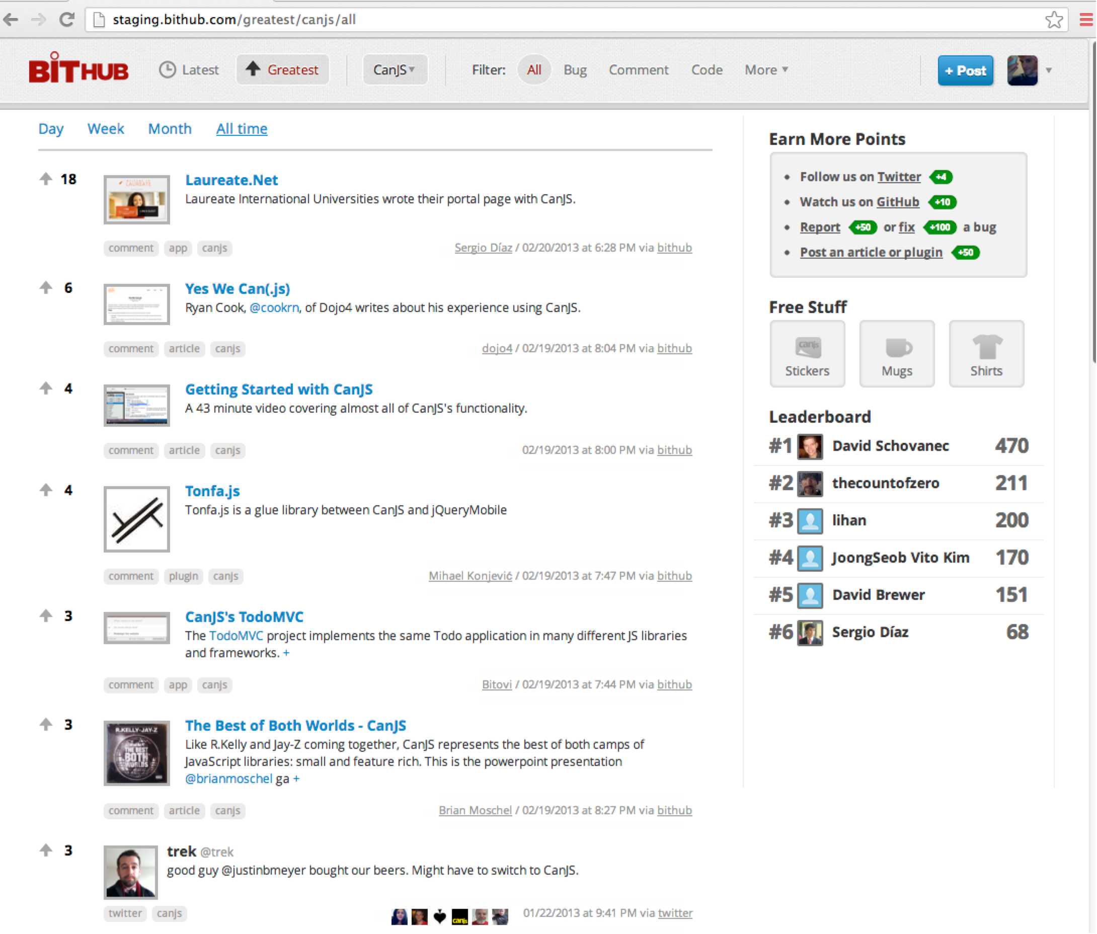

Slide 86


Slide 87
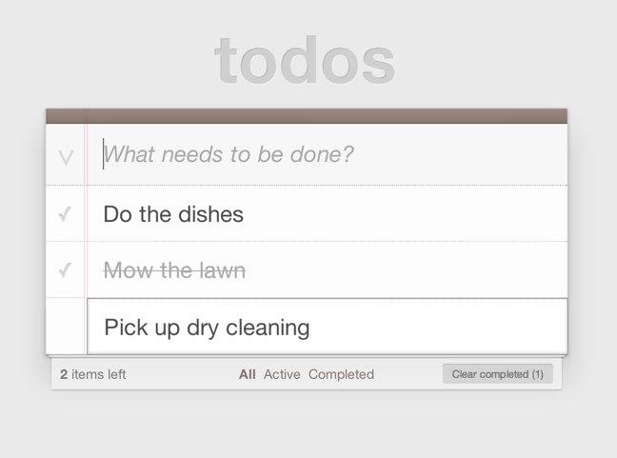
TodoMVC

Slide 88
Meetup Locations
Chicago
Los Angeles
San Francisco
Raleigh
Dallas
Fort Lauderdale
Seattle
Phoenix
New York
Boston

Slide 89
Future meetup material
can.Map and can.List
can.compute
can.Mustache
can.Component
can.Control
can.Model and can.fixture
can.route
can.control
can.EJS
Architecture
Testing
Contributing
Notes:
Be an expert at CanJS in 12 months.

Slide 90
Meetup Goals
Become an expert
Get help
Make friends
Notes:
Be an expert at CanJS in 12 months.

Slide 91
Learn CanJS

Slide 92
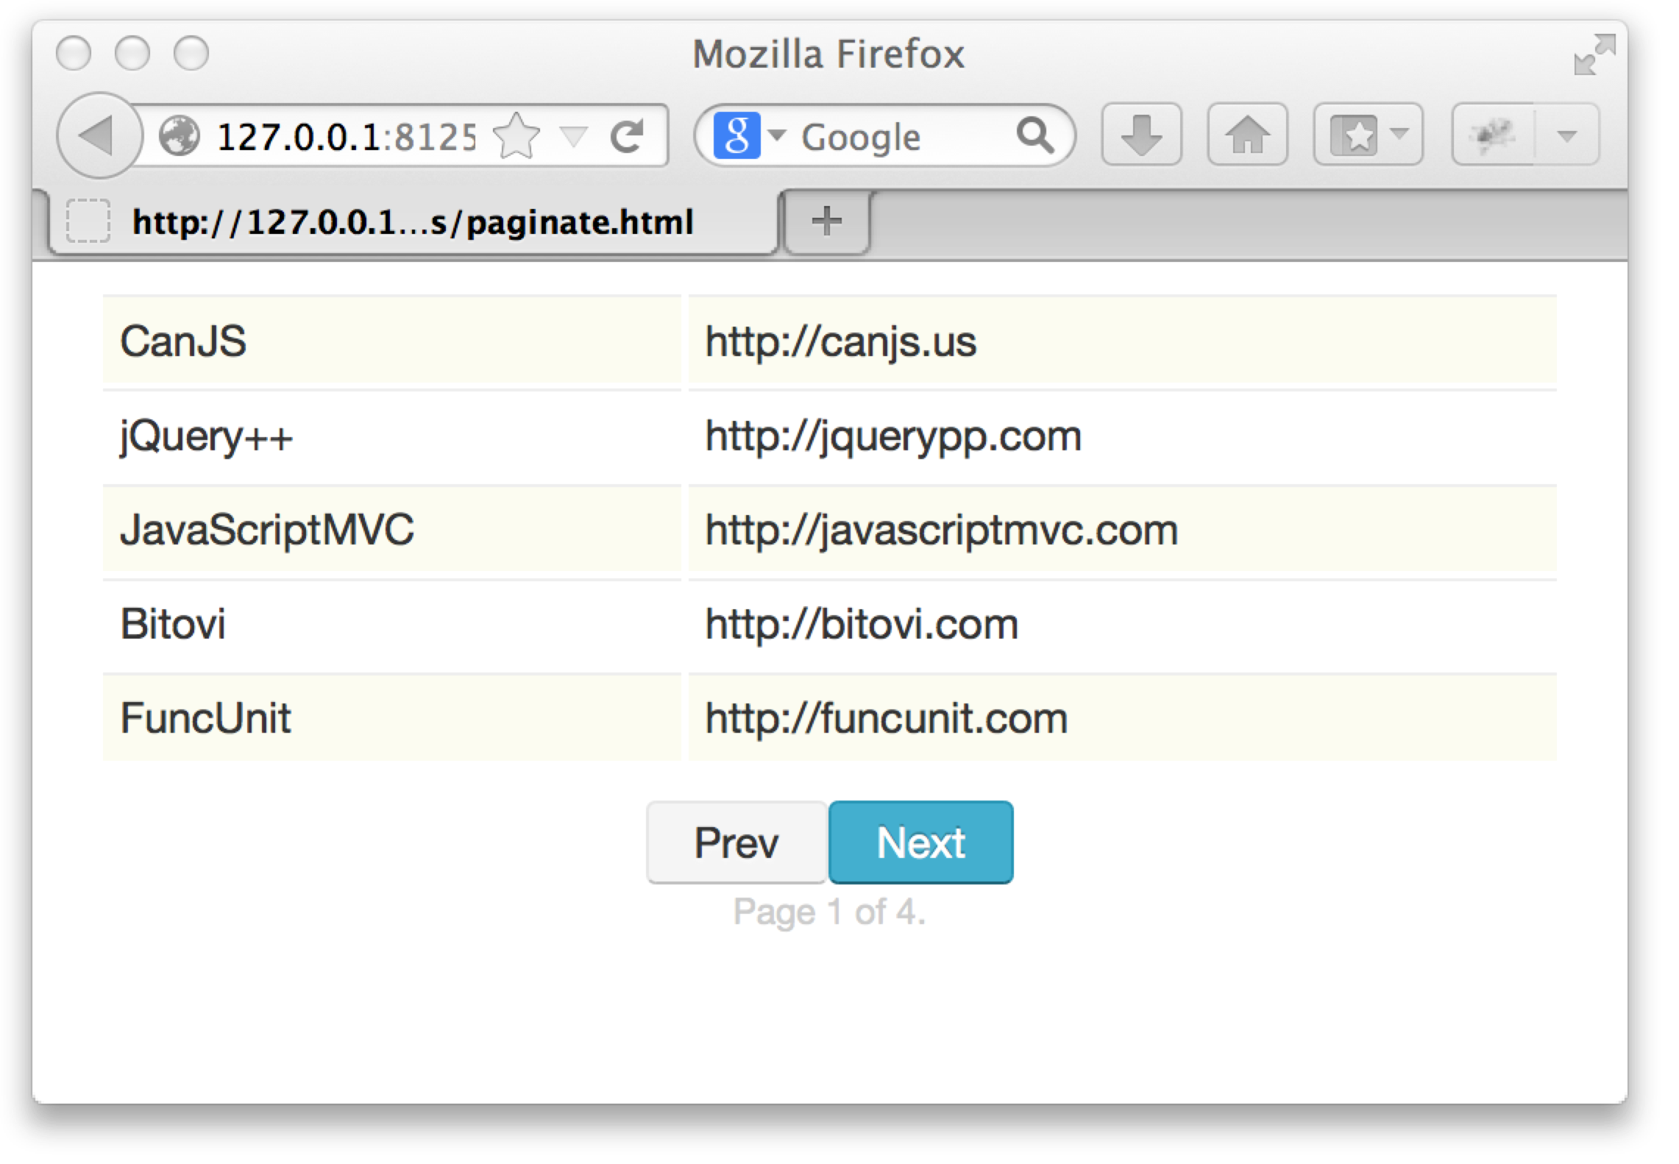
Paginate Demo
http://tinyurl.com/canjs-comp-ex

Slide 93
List Websites
<table id="websites"></table>
<script id="sites" type="text/mustache">
{{#each websites}}
<tr>
<td width='40%'>{{name}}</td>
<td width='70%'>{{url}}</td>
</tr>
{{/each}}
</script>

Slide 94
List Websites
var Website = can.Model.extend({
findAll: "/websites"
}, {});
Website.findAll( {limit:5, offset:0 },
function(webs){
var frag = can.view("sites",{
websites: webs
})
$("#websites").html( frag )
})

Slide 95
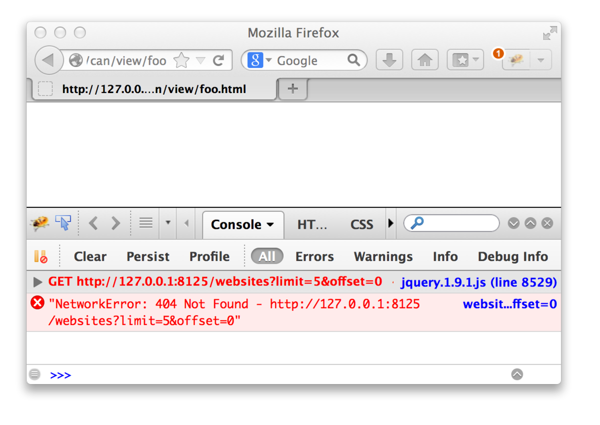
List Websites

Slide 96
Fixtures
var websites = [
{id:1,name:"CanJS",url:"http://canjs.us"},…
];
can.fixture("/websites", function(request){
var start = request.data.offset || 0,
end = start + request.data.limit;
return {
count: websites.length,
data: websites.slice(start, end)
}
});

Slide 97
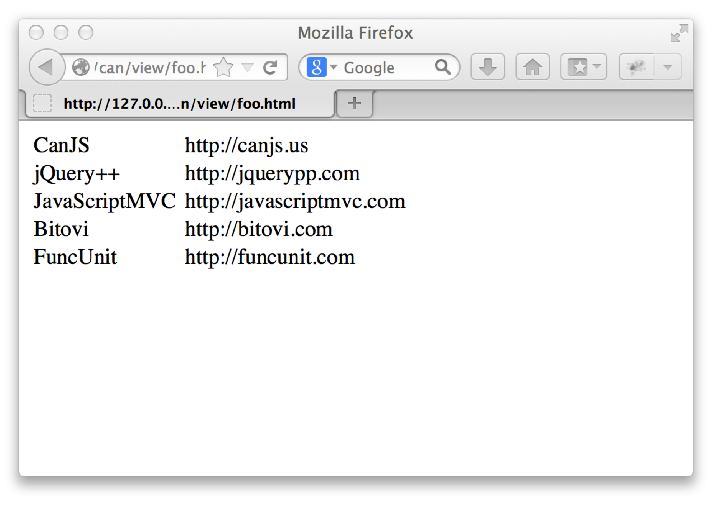
List Websites

Slide 98
Widgets and State?
Grid
.limit
.offset
.count
NextPrev
PageCount

Slide 99
Paginate State
var paginate = new can.Map({
limit: 5, offset: 0, count: 15
});
paginate.bind("offset",function(ev,newVal){
Website.findAll({limit:5,offset: newVal},
function(websites){
$("#websites").html( can.view("sites",{
websites: websites
})
})
});

Slide 100
Paginate Compute
var websitesCompute = can.compute(function(){
var param = {
limit: paginate.attr('limit'),
offset: paginate.attr('offset')
}
return new Website.List(param);
});
$("#websites").html( can.view("sites",{
websites: websitesComp
}));

Slide 101
Paginate Model
var Paginate = can.Map.extend({
count: Infinity,
offset: 0,
limit: 5,
next: function () {
this.attr('offset',
this.offset + this.limit);
}
});
var paginate = new Paginate();
paginate.next();

Slide 102
Paginate Model - Setters
var Paginate = can.Map.extend({
…
prev: function () {
this.attr('offset',
this.offset - this.limit);
},
setOffset: function (newOffset) {
return newOffset < 0 ?
0 :
Math.min(newOffset,
!isNaN(this.count - 1) ?
this.count - 1 :
Infinity)
}
});

Slide 103
Paginate Model - Helpers
var Paginate = can.Map.extend({
next: function () { … },
prev: function () { … },
setOffset: function () { … },
setCount: function () { … },
canNext: function () { … },
canPrev: function () {
return this.attr('offset') > 0
},
page: function () { … },
pageCount: function () { … }
});

Slide 104

NextPrev
new NextPrev("#next-prev",{
paginate: paginate
});

Slide 105
NextPrev’s Template
<script id="next-prev-stache"
type="text/mustache">
<a class="prev
{{#paginate.canPrev}}
enabled
{{/paginate.canPrev}}">Prev</a>
<a class="next
{{#paginate.canNext}}
enabled
{{/paginate.canNext}}">Next</a>
</script>

Slide 106
NextPrev can.Control
var NextPrev = can.Control({
init: function(){
this.element.html(
can.view('next-prev-stache',
this.options) );
},
".next click" : function(){
this.options.paginate.next();
},
".prev click" : function(){
this.options.paginate.prev();
}
});

Slide 107
NextPrev can.Component
<next-prev paginate='paginate'></next-prev>

Slide 108
NextPrev can.Component
can.Component.extend({
tag: "next-prev",
template:
'<a class="prev ' +
'{{#paginate.canPrev}}' +
'enabled' +
'{{/paginate.canPrev}}" ' +
'can-click="paginate.prev">Prev</a>'+
'<a class="next ' +
'{{#paginate.canNext}} ' +
'enabled' +
'{{/paginate.canNext}}" ' +
'can-click="paginate.next">Next</a>'
})

Slide 109
NextPrev can.Component
can.Component.extend({
tag: "next-prev",
template: can.view('next-prev-stache')
})

Slide 110

PageCount can.Component
<page-count
page='paginate.page'
count='paginate.pageCount'>
</page-count>

Slide 111
PageCount can.Component
can.Component.extend({
tag: "page-count",
template: 'Page <span>{{page}}</span> ' +
'of <span>{{count}}</span>.'
})

Slide 112
can.Component.extend(p)
can.Component.extend({
tag:"panel",
template: "{{#if active}}<content>…",
scope: {
active: false
},
helpers: {}
events: {
inserted: function(){...}
}
})
Notes:
JavaScript has 10 basic data types.
mutable

Slide 113
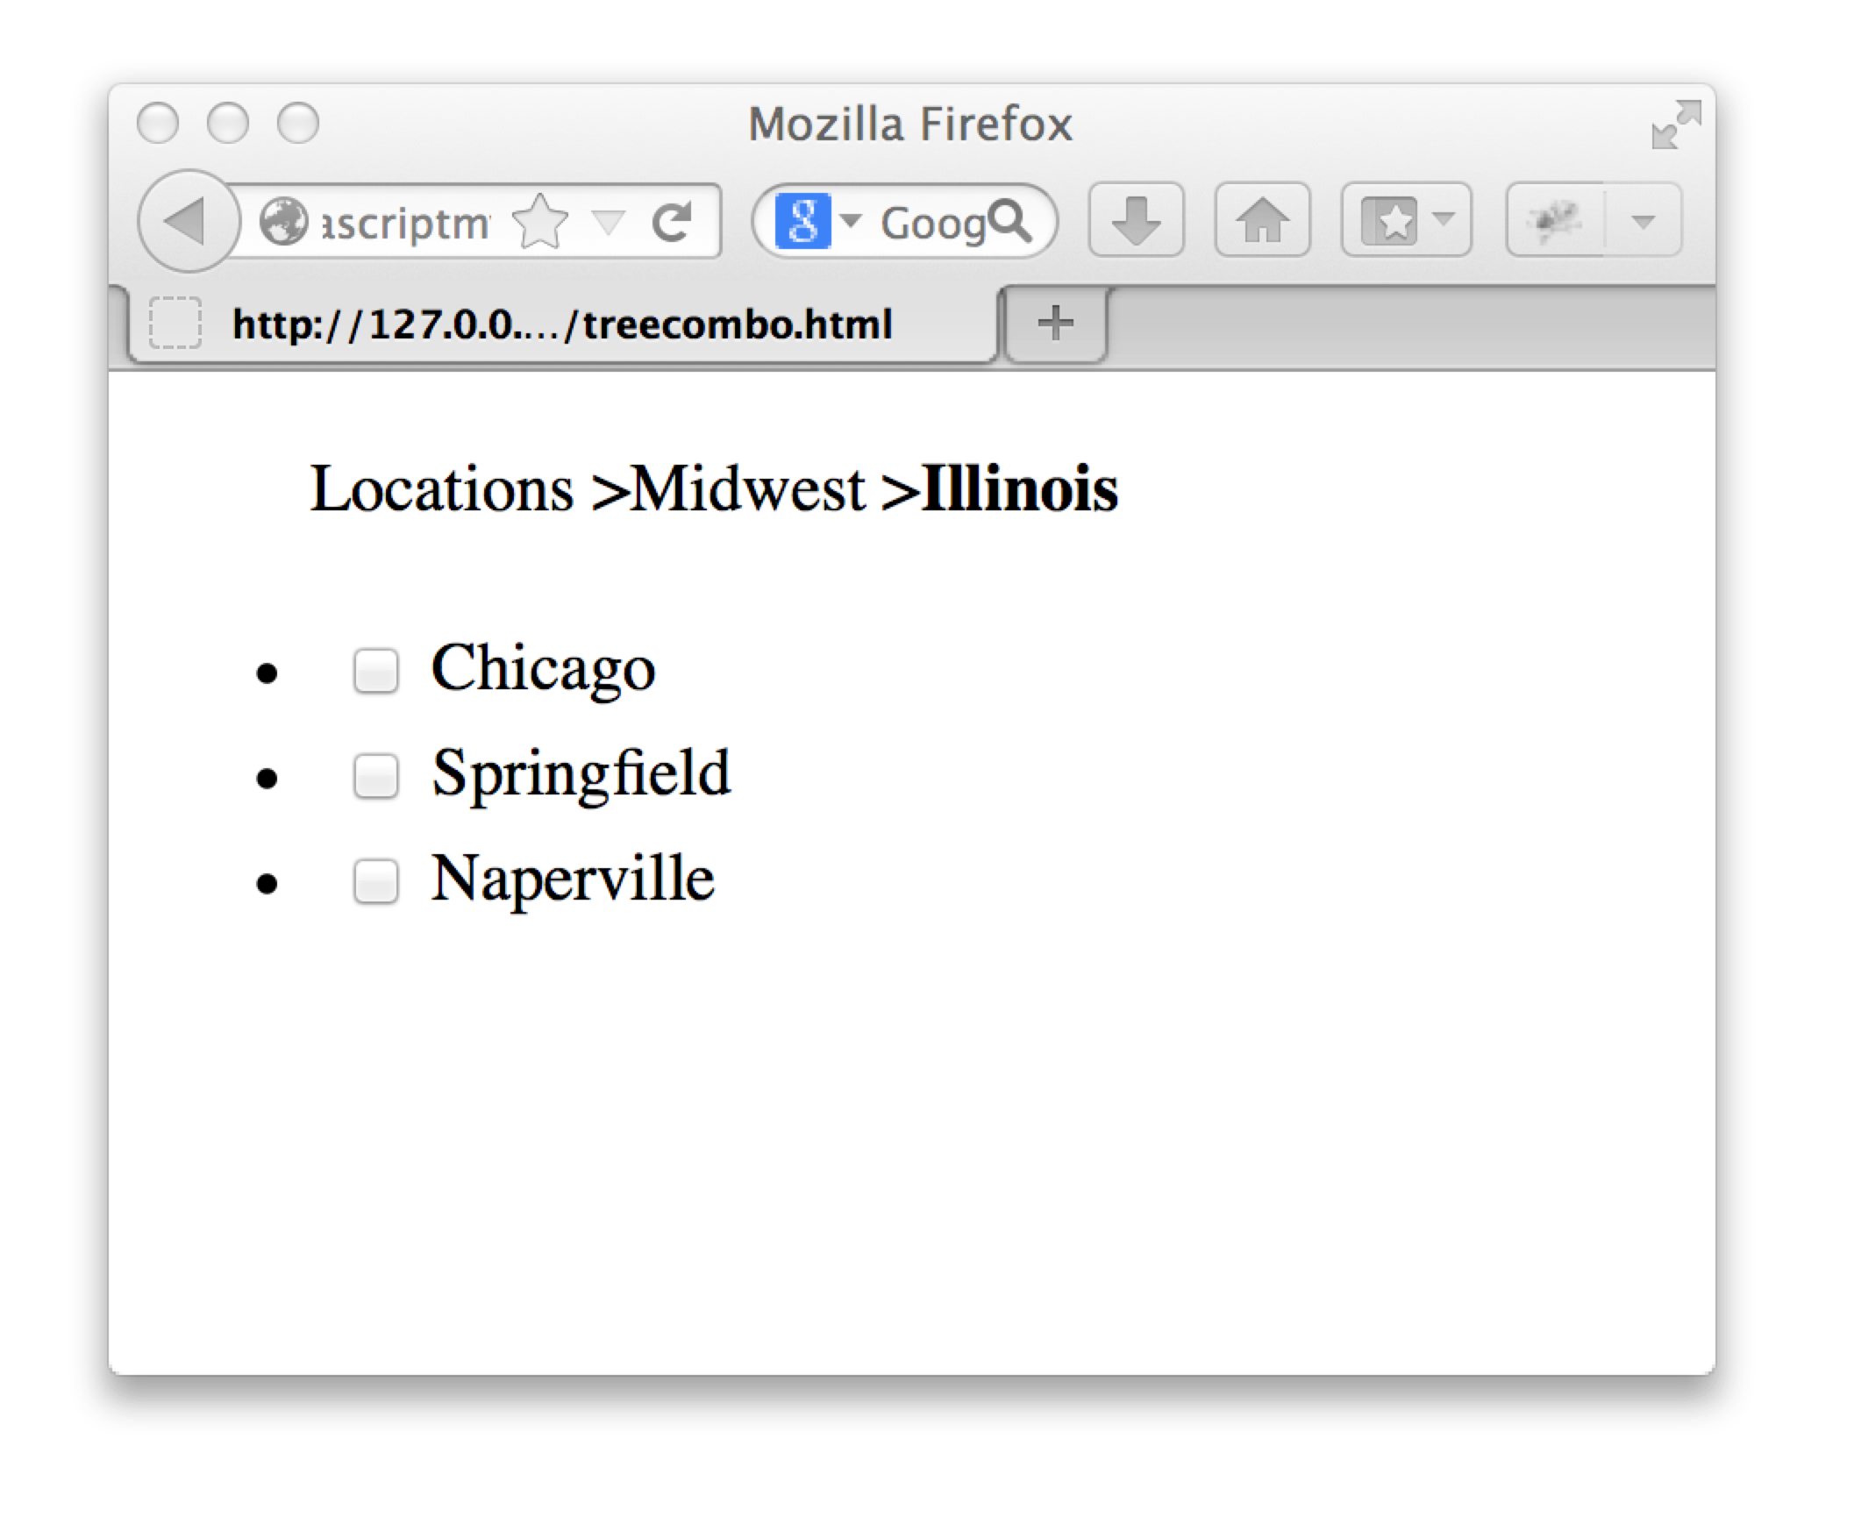

Slide 114
